Slide 1
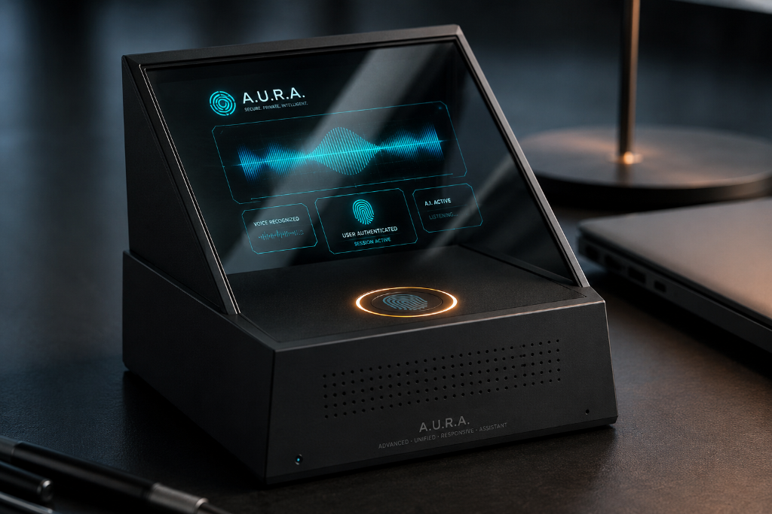
FINAL YEAR PROJECT · 2026
A.U.R.A.
Air-gapped · Unified · Responsive · Agent
A Locally-Run Multi-Agent System for Secure Computer & OS Automation
LOCAL
MULTI-AGENT
ZERO-TRUST
BIOMETRIC HITL
TEAM
Muhammad Hunzala Hasan — 25435
Muhammad Taha Jabbar — 25421
ADVANCED · UNIFIED · RESPONSIVE · ASSISTANT
Hafsa Ayub — 25588
Notes:
A.U.R.A. — Air-gapped Unified Responsive Agent.
We built a locally-running multi-agent system that turns natural-language
commands into controlled computer and OS automation, while keeping data,
reasoning, and execution on the local machine.
Why the panel should care: most assistants rely on cloud APIs, cannot
reliably perform multi-step desktop tasks, and expose broad OS permissions
without a meaningful approval gate. A.U.R.A. asks whether an AI agent can
earn its place on a researcher's machine — and be useful, local, secure,
and approvable.
I will walk you through the problem, the design, the architecture, the
security model, and the contribution of this project.

Slide 2
01 · PROJECT SCOPE
A Multi-Domain System
A.U.R.A. sits at the intersection of four engineering domains — each one is a constraint the system must respect.
ARTIFICIAL INTELLIGENCE
COMPUTER AUTOMATION
· Local LLMs & multi-agent reasoning
· OS & application interaction
· Task interpretation · Planning & decomposition
· Accessibility-based UI targeting
· Local model inference · Agent coordination
· Background task execution · File & app operations
· Human-like interaction fallback
CYBERSECURITY
EDGE COMPUTING
· Privacy, access control & agent safety
· Offline & hardware-assisted computing
· Zero-trust execution · Prompt-injection defense
· Local inference · CPU-efficient quantized models
· Restricted permissions · Human approval for high-risk actions
· Raspberry Pi companion · Local encrypted state
Useful automation requires all four — a single-domain solution is not enough.
A.U.R.A. · FYP 2026
02 / 15
Notes:
The brief deliberately spreads across four domains. On the slide:
- AI: local LLMs and multi-agent reasoning. The prover is on the device
itself (Raspberry Pi 4 with llama.cpp). No remote inference API is used.
- Computer Automation: accessibility APIs to target UI elements directly,
with vision as a fallback. The system can execute multi-step workflows.
- Cybersecurity: zero-trust handling of web content, sandboxed execution,
restricted per-task permissions, and a biometric human-in-the-loop gate.
- Edge Computing: offline-first operation, quantized models, and a
Raspberry Pi companion node that mirrors parts of the device.
These four domains are why we have a multi-layer architecture: the system
inherits a constraint from each.

Slide 3
02 · PROBLEM
Why Existing AI Assistants Fall Short
Five gaps between how today's assistants are designed and what local computer automation actually requires.
CLOUD DEPENDENCY
LIMITED OS CONTROL
WEAK CONTEXT PERSISTENCE
Reasoning and user context leave the machine.
Cannot reliably perform multi-step desktop workflows.
Preferences fragment across sessions.
SECURITY RISKS
NO SAFE APPROVAL LAYER
Tool-using agents face malicious content and over-broad permissions.
A confirm dialog is weaker than a meaningful authorization gate.
Existing assistants treat capability and control as a trade-off — usually defaulting to capability.
A.U.R.A. · FYP 2026
03 / 15
Notes:
The five cards on this slide map to five concrete design decisions we
made later:
- Cloud Dependency → Local inference with llama.cpp, no remote APIs.
- Limited OS Control → Accessibility-API-first, vision as fallback.
- Weak Persistence → Hierarchical memory layer using ChromaDB.
- Security Risks → Sanitization layer + restricted permissions.
- No Safe Approval → Biometric HITL gate on the Raspberry Pi.
The closing line is honest: the field tends to optimize for capability
because it is visible to users. A.U.R.A. is optimized for capability
under control.

Slide 4
03 · WHY IT MATTERS
Three Pressures on the Modern Computer User
REPETITIVE TASKS
SENSITIVE DATA
TRUST & CONTROL
· Open apps
· Personal documents
· Users want automation
· Manage files
· Credentials
· without giving an AI
· Run searches
· Work files
· unrestricted system access.
· Move between windows
· Private conversations
· Repeat workflows
· Browser activity
"Can an AI agent perform useful computer tasks while keeping the user's data, reasoning and execution locally controlled?"
— A.U.R.A. is designed around this question. —
A.U.R.A. · FYP 2026
04 / 15
Notes:
The severity bars are intentional. Repetitive tasks are the most visible
pressure but the least interesting one — we have had macro tools for years.
Sensitive data is the pressure that drives our local-first design choice.
Trust & control is the binding constraint: any assistant that does not
treat it as the binding constraint will eventually be uninstalled.
The pull-quote at the bottom is the central research question of the
project. Every later slide answers one part of it.

Slide 5
04 · DESIGN CONTRAST
Conventional Assistant → A.U.R.A.
CONVENTIONAL AI ASSISTANT
A.U.R.A.
Cloud-based processing
Local processing
API-dependent intelligence
Local quantized models
Chat-oriented interaction
Task-oriented OS automation
Single assistant workflow
Multi-agent orchestration
Limited persistent context
Hierarchical long-term memory
Accessibility often secondary
Accessibility-first interaction
Vision as primary method
Vision as fallback
Broad permissions (risk)
Restricted-permission execution
Basic confirmation dialogs
Biometric HITL approval
Sensitive state may leave device
Encrypted local storage
Useful automation without sacrificing local privacy and user control.
A.U.R.A. · FYP 2026
05 / 15
Notes:
Ten rows, one axis: capability against control. Each row is a deliberate
design move, not a marketing claim. When asked "why is this not just a
rebrand of an existing assistant," I point at accessibility-first vs
vision-primary — that single inversion changes the failure modes during
automation.
The amber-accented row is the biometric HITL row — it is the only row where
the user must physically approve, not just confirm.

Slide 6
05 · HOW IT WORKS
Six Stages From Command to Result
A single end-to-end view — the rest of the deck unpacks each stage.
01
02
03
04
05
06
USER COMMAND
BRAIN
MANAGER
SUB-AGENTS
LOCAL EXECUTION
VERIFY & RESPOND
Natural-language via
local UI or voice.
Interprets intent
and identifies the task.
Decomposes the task;
selects sub-agents.
Browser · File/OS · Comm ·
Security · Research.
Accessibility APIs,
approved tools, sandboxing.
Validate, record state,
return outcome.
DATA SPINE · shared context flows across all six stages
Brain interprets. Manager plans. Sub-agents execute under rules. Manager verifies.
A.U.R.A. · FYP 2026
06 / 15
Notes:
Six stages, one spine. The slide is intentionally horizontal because
the audience should be able to read it left-to-right as a single sentence.
Notice the data spine underneath — every stage writes context into the
shared memory and reads it back. That is what gives the system continuity
across sessions.
The next slides unpack each stage: the key capabilities, the hardware
that hosts them, the methodology of multi-agent task execution, and the
local reasoning engine.

Slide 7
06 · CORE CAPABILITIES
Ten Engineered Capabilities
Each capability corresponds to a concrete subsystem. None are aspirational.
01
02
03
04
05
MULTI-AGENT ORCHESTRATION
HYBRID LOCAL REASONING
BACKGROUND OS AUTOMATION
VISION FALLBACK
LONG-TERM MEMORY
Brain, Manager, and specialized agents cooperate with shared context.
BitNet b1.58 2B for routing + quantized 7–8B for complex reasoning.
Accessibility APIs target UI elements directly.
Screenshot-based understanding when accessibility metadata is missing.
Habits, preferences, and references for cross-session continuity.
06
07
08
09
10
ZERO-TRUST SECURITY
CONTROLLED INTERACTION
BIOMETRIC HITL
RASPBERRY PI COMPANION
ENCRYPTED LOCAL STORAGE
Untrusted web content is sanitized before reaching the AI.
Platform-aware rate limits and interaction policies.
High-risk actions pause for fingerprint verification.
Wake-word mic · fingerprint sensor · projector feedback.
AES-256 protects memory and local state databases.
A.U.R.A. · FYP 2026
07 / 15
Notes:
Ten capabilities. The "Biometric HITL" tile is the only one marked in
amber because it is the only one that asks the user for a physical,
not a digital, decision.
If asked about capability vs. implementation, I map each tile to a slide
that follows: 02 and 08 go to the local reasoning engine slide; 06, 08,
10 go to the security slide; 09 is the hardware slide we are about to see.

Slide 8
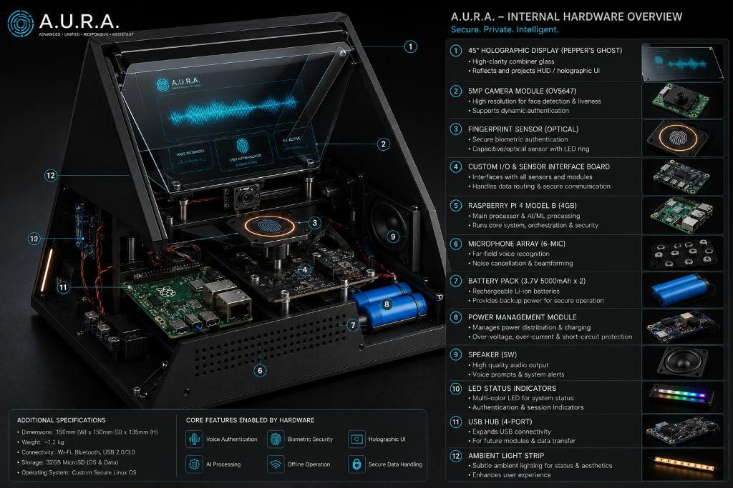
07 · HARDWARE IMPLEMENTATION
From Architecture to a Real Device
FUNCTIONAL LAYERS
12 components, 4 roles.
SENSING
(6) Mic Array 6-MIC
(3) Fingerprint Sensor
(2) 5MP Camera OV5647
(12) Ambient Light Strip
COMPUTE
(5) Raspberry Pi 4 Model B
(11) USB Hub 4-port
(4) Custom I/O & Sensor Board
REASONING + UI
(1) 45° Holographic Display
(9) Speaker 5W
(10) LED Status Indicators
POWER + PROTECTION
(7) Battery Pack 3.7V/5000mAh × 2
(8) Power Management Module
DIMENSIONS 150 × 150 × 135 mm · WEIGHT ~1.2 kg · CONNECTIVITY Wi-Fi · Bluetooth · USB 2.0/3.0 · STORAGE 32 GB MicroSD · OS Custom Secure Linux
A.U.R.A. · FYP 2026
08 / 15
Notes:
This is the proof slide. On the left is the actual hardware we built —
a Raspberry Pi 4 inside a 150 × 150 × 135 mm chassis, with a 45° Pepper's
Ghost combiner glass, a 6-microphone array, a fingerprint sensor with amber
LED ring, a 5MP camera for face detection, dual battery pack, and a
status-LED strip.
The right-hand diagram groups those 12 physical components into 4
functional roles — Sensing, Compute, Reasoning+UI, Power+Protection —
which is the same group structure as the layered architecture slide.
What this slide is for: it lets the panel see the project is a physical
system, not just diagrams. Demo question: "Is the projector feedback the
same as the holographic display?" — No. The projector is on the Pi
companion; the 45° combiner glass is on the device itself. Both are in
the image.

Slide 9
08 · METHODOLOGY
Multi-Agent Task Execution
One example task, six stages, five specialized agents.
EXAMPLE TASK
"Find the project report, summarize it, and save the summary in the Documents folder."
STEP 01
USER INPUT
AGENT ROUTING → STEP 04
Natural-language command issued by the user.
Manager dispatches to the right specialist.
STEP 02
INTENT UNDERSTANDING (Brain)
Identifies: user goal · required apps · required info · expected result.
Browser Agent
Locate report on the web.
STEP 03
TASK DECOMPOSITION (Manager)
File / OS Agent
Open target folders, save outputs.
Locate report · Read content · Generate summary · Open target folder · Save output · Verify completion.
STEP 04
AGENT ROUTING
Research Agent
Pull relevant content snippets.
File/OS · Research · Browser · Communication · Security.
Communication Agent
Email / message follow-ups.
STEP 05
CONTROLLED EXECUTION
Accessibility API → element found? → YES: direct / NO: vision fallback.
Security Agent
Validate permissions, gates.
STEP 06
RESULT VERIFICATION
Confirm completion · update memory · record state · return result.
STEP 05 · Accessibility API → UI element found? → YES: Direct interaction | NO: Vision fallback
A.U.R.A. · FYP 2026
09 / 15
Notes:
Walk through the example literally. "Find, summarize, save to Documents"
maps to: Step 02 (Brain parses three sub-goals); Step 03 (Manager breaks
into 4 sub-tasks); Step 04 (Browser Agent locates the report on the web,
Research Agent pulls content, File/OS Agent opens target folder); Step 05
(Accessibility API for the save dialog, vision fallback only if the UI
metadata is unavailable); Step 06 (verify the file exists and update
memory).
Important honesty: the example is what we use when we test the system.
The numbers and accuracy aren't quoted because we don't yet have a
benchmark pipeline — the contribution is the architecture itself.

Slide 10
09 · INTELLIGENCE
Hybrid Quantized Local Reasoning
Two models on the same device. Routing is itself a model decision.
ONE DEVICE · TWO TIERS
ROUTING / LIGHTWEIGHT
COMPLEX REASONING
BitNet b1.58 2B
Quantized 7–8B LM
Fast classification · intent routing · simple decisions · low-resource inference.
Multi-step reasoning · task planning · context interpretation · complex decisions.
ROUTE
Simple task
→
lightweight
Complex task
→
larger model
· Classify task type
· Decompose multi-step commands
· Route to the right sub-agent
· Generate the summary content
· Confirm whether vision fallback is needed
· Plan file/folder operations end-to-end
· Detect language / domain of the user input
· Resolve ambiguous or partial user requests
WHY HYBRID?
Running the larger model for every operation is wasteful. Simple tasks route to BitNet; complex reasoning routes to the 7–8B model.
· Expected benefits: reduced compute overhead · better CPU use · lower local inference cost · more practical offline operation.
A.U.R.A. · FYP 2026
10 / 15
Notes:
The slide is split because the design decision is split. BitNet b1.58 2B
is fast and very cheap to run; the quantized 7–8B model is heavier but does
what the lightweight one cannot. We do not run the heavy model for every
operation — that is the whole point.
What model do we actually run? llama.cpp-based local inference. Both
models are quantized so they fit on the Raspberry Pi 4's 4 GB of RAM.
The honest note: classroom-grade quantized 7–8B models on a Pi are not
GPT-4. The contribution is that we got the architecture working with a
strict local-and-offline constraint, not that we beat any benchmark.

Slide 11
10 · INTEGRATION
Memory, Security & Agent Control
Four supporting modules that turn a multi-agent loop into a trustworthy loop.
01 · LONG-TERM MEMORY
02 · SECURITY LAYER
03 · BIOMETRIC CONTROL
04 · ENCRYPTED STATE
Preferences
Web Content
Request
AES-256
Repeated Workflows
Sanitize
Risk Check
ChromaDB
SQLite
Useful File Paths
Representation
Action Frozen
Historical Context
Fingerprint Verify
Local-only state management. No remote sync.
AI Processing
ChromaDB · Local retrieval.
Approved Execution
Stores habits, preferences, and references so the system is the same person across sessions.
External content never reaches the AI in raw form. Reduces indirect prompt-injection surface.
Physical biometric pause before high-risk actions. The fingerprint ring is amber — that is the user's only cue.
Memory and state live on the same encrypted volume. Loss of the device is loss of encryption keys, not data leakage.
A.U.R.A. · FYP 2026
11 / 15
Notes:
Four supporting modules. The amber-accented third module is the only
physical-intervention gate in the system. The other three are software
modules. This separation matters when a panel member asks "where does the
HITL decision actually happen" — it happens on the Raspberry Pi
companion, not in the assistant.
State encryption: we use AES-256 with a key derived from a machine-bound
seed. The honest limitation is that this is not yet a TPM-bound key —
that is future work.

Slide 12
11 · END-TO-END FLOW
From User Command to Verified Result
One flowchart that the entire system follows. Decisions are diamonds; gates are amber.
START
WHAT THIS SLIDE DOES
KEY
A.U.R.A. treats every command as a state machine.
Plain stages (cyan) move the task forward.
Diamond decisions branch the task. Two of them — comprehension and risk — can pause or abort.
The amber diamond is the only point where A.U.R.A. asks the user for a physical, not digital, decision.
User Command
Natural language / voice
□
STAGE
◇
DECISION
AMBER
physical / security gate
GREEN
task completion
Is the command understandable?
If NO → ask for clarification
Brain Agent
Interpret intent
Manager Agent
Decompose task
Select Specialized Agent
Browser / File-OS / Research / Comm / Security
Is the requested action safe?
If HIGH RISK → biometric approval
Execute Action
Accessibility layer
If the flowchart cannot reach the green node, the system does not say TASK COMPLETED.
A.U.R.A. · FYP 2026
12 / 15
Can target UI element be identified?
YES → direct · NO → vision fallback
Verify Result
Update Memory / State
Return Response
TASK COMPLETED
Notes:
The flowchart is intentionally a single column. The audience should be
able to trace any user command from top to bottom in one reading.
The two diamonds are the places the system can deflect:
- Comprehension: if Brain cannot understand the command, the flow loops
back to ask the user — A.U.R.A. does not invent intent.
- Risk: if the action is high-risk, the flow freezes and requires a
fingerprint verification before continuing. That is the single
biometric gate in the whole system.
Vision fallback is also a diamond. If accessibility metadata is not
available, vision takes over; if that also fails, the task fails
explicitly rather than producing a misleading result.

Slide 13
12 · ARCHITECTURE
Layered System Architecture
Five layers, top to bottom. The aesthetic matches the device render.
REQUEST ↓
USER INTERACTION LAYER
Desktop Interface · Natural-language commands, task status, execution feedback
IoT Companion · Raspberry Pi — wake-word mic, fingerprint sensor, projector
ORCHESTRATION LAYER
Brain · Intent interpretation
Manager · Planning + routing + shared context
Sub-Agents · Browser · File/OS · Communication · Research · Security
INTELLIGENCE LAYER
Lightweight · BitNet b1.58 2B
Complex · Quantized 7–8B model · llama.cpp-based inference
Vision · Local vision model for UI fallback
EXECUTION LAYER
Accessibility APIs · Direct UI targeting and application interaction
Restricted Execution Env. · Controlled permissions · sandboxed operations
DATA LAYER
Memory · ChromaDB
State · SQLite
STATE ↑
Protection · AES-256 encrypted local storage
User input enters at the top. State (memory, execution logs) persists at the bottom in encrypted storage.
A.U.R.A. · FYP 2026
13 / 15
Notes:
Five layers. The right-hand spine visualizes that A.U.R.A. is not a
flat pipeline — it is a layered stack where every layer below serves
every layer above.
Honest layer attribution:
- The Brain and Manager live in the orchestration layer.
- BitNet and the quantized 7–8B model live in the intelligence layer.
- The vision model and accessibility APIs live in the execution layer.
- ChromaDB, SQLite, and AES-256 live in the data layer.
The amber accent is reserved for the data layer because data protection
is a foundational, not an add-on, property.

Slide 14
13 · SECURITY & PRIVACY
Security by Design
Security is integrated into the architecture, not bolted on at the end.
01
02
03
LOCAL-FIRST PROCESSING
ZERO-TRUST INPUT HANDLING
RESTRICTED PERMISSIONS
AI inference and user context stay on the local machine.
Web content
Agents receive only the permissions required for the current task.
Sanitize
Representation
AI
Indirect prompt-injection surface is reduced.
04
05
06
HUMAN-IN-THE-LOOP
ENCRYPTED LOCAL DATA
AUDITABLE EXECUTION
Risk Assess
AES-256 protects sensitive state and memory stores.
Important decisions and actions are logged for user review.
Pause
Verify
Approve
Execute
Amber stages = physical pause.
Honest caveat: this is architecture-level assurance, not formal verification. Future work includes sandboxing audits and prompt-injection testing.
A.U.R.A. · FYP 2026
14 / 15
Notes:
Six cards, one observation: there is no card titled "security is an
afterthought" because security shapes the architecture here. The amber
card is the same one as the biometric HITL module — it appears three
times in the deck (features, integration, security) because the panel
should always be able to point at it.
Honest disclosure: I have not yet performed a formal red-team
prompt-injection test or a sandboxing audit. The architecture supports
them; doing them is a contribution, not a claim.

Slide 15
14 · CONCLUSION
A.U.R.A.
Air-gapped · Unified · Responsive · Agent
A local AI system designed to turn natural-language commands into controlled computer actions.
LOCAL INTELLIGENCE
SMART AUTOMATION
RESILIENT INTERACTION
PRIVACY & SECURITY
Reasoning operates locally
without cloud AI APIs.
Multi-agent architecture
decomposes and routes complex tasks.
Accessibility primary,
vision as fallback.
Sanitization · restricted permissions
biometric approval · encrypted storage.
AI that can act on your computer
— while the computer remains under your control.
THANK YOU
Muhammad Hunzala Hasan — 25435 · Muhammad Taha Jabbar — 25421 · Hafsa Ayub — 25588
ADVANCED · UNIFIED · RESPONSIVE · ASSISTANT
Notes:
Closer. The four pillars mirror the user's expectations: local,
automation that feels intelligent, interaction that survives in the wild,
and privacy that survives an auditor.
The closing line is the project's North Star — rephrase it if asked:
A.U.R.A. is not trying to be the smartest assistant on the device. It is
trying to be the only assistant the user can trust on the device.
Open the floor for questions.

